Slide 1
Strassen Matrix Multiplication Algorithm
A Parallel Implementation
Honghao Tian
James Mwaura

Slide 2
Introduction
Published in 1969 by Volker Strassen.
Works on matrices of size 2^{n} x 2^{n}
Works by reducing the total number of multiplication operations.
3 main phases

Slide 3
The Algorithm
Phase 1
Phase 2

Slide 4
The Algorithm Contd.
Phase 3
Algorithm applied recursively at phase 2, till appropriate granularity is achieved.

Slide 5
Comparison to Regular Method
Normally, the process would be:
Strassen’s method reduces the number of multiplication operations to 7, not 8
Normal method: O(N³)
Strassen’s method: O(N^{2.8})
Possible downside: Reduced numerical stability

Slide 6
OpenMP Implementation
Recursive implementation in OpenMP
All iterative processes are parallelized.
Used 1, 2 and 4 threads
Minimum granularity set at 64x64 Matrix size.
Highly memory intensive due to the numerous sub-matrices created in the recursive process.

Slide 7
Recursive Function
C=A*B
M1
M1->M1
M1->M2
M2
……
M3
M4
M5
M6
M7
M1->M3
……
……
……

Slide 8
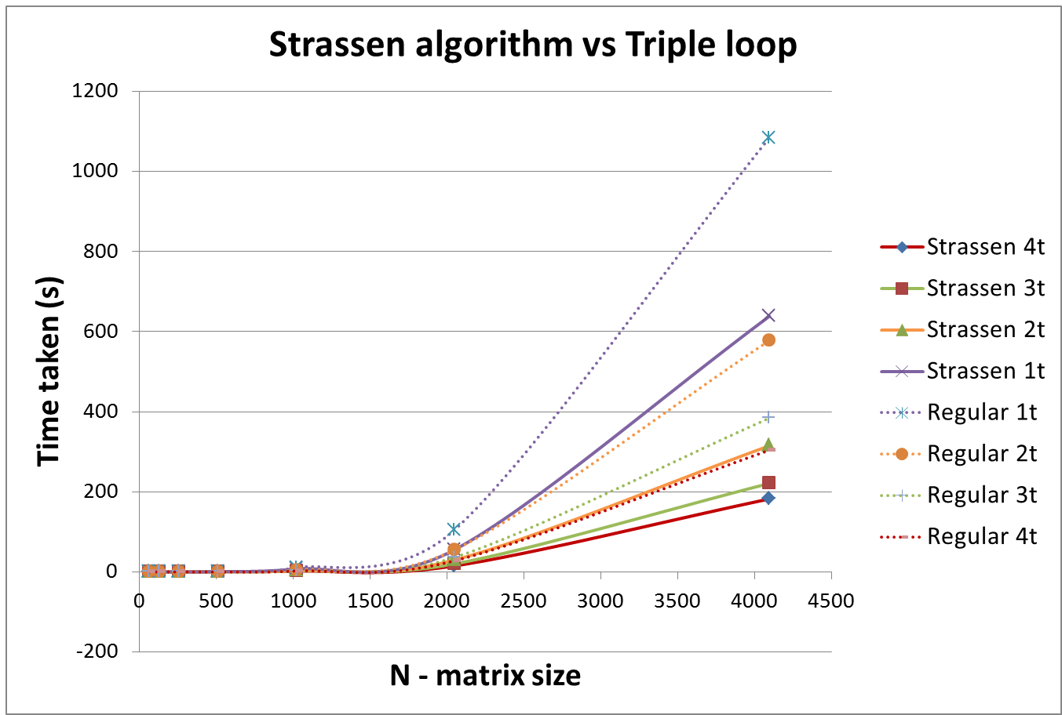
Results

Slide 9
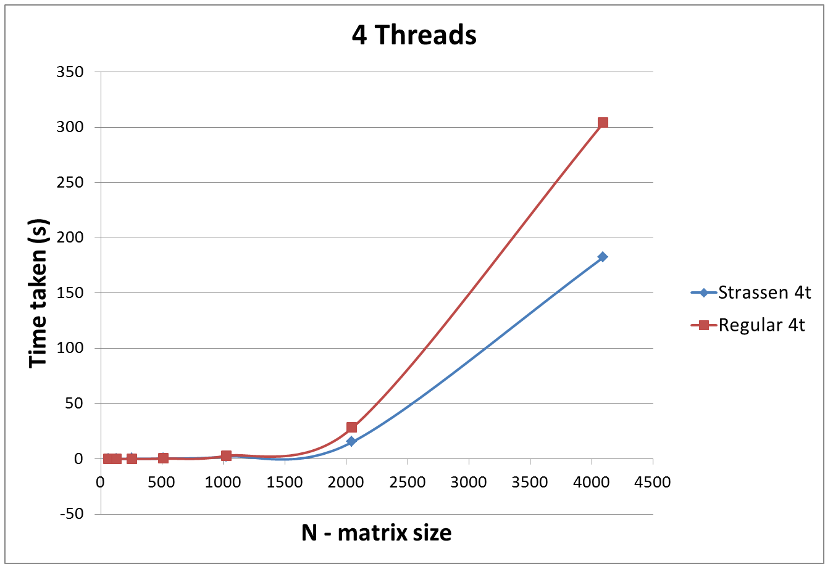
Results, Multi-threaded

Slide 10
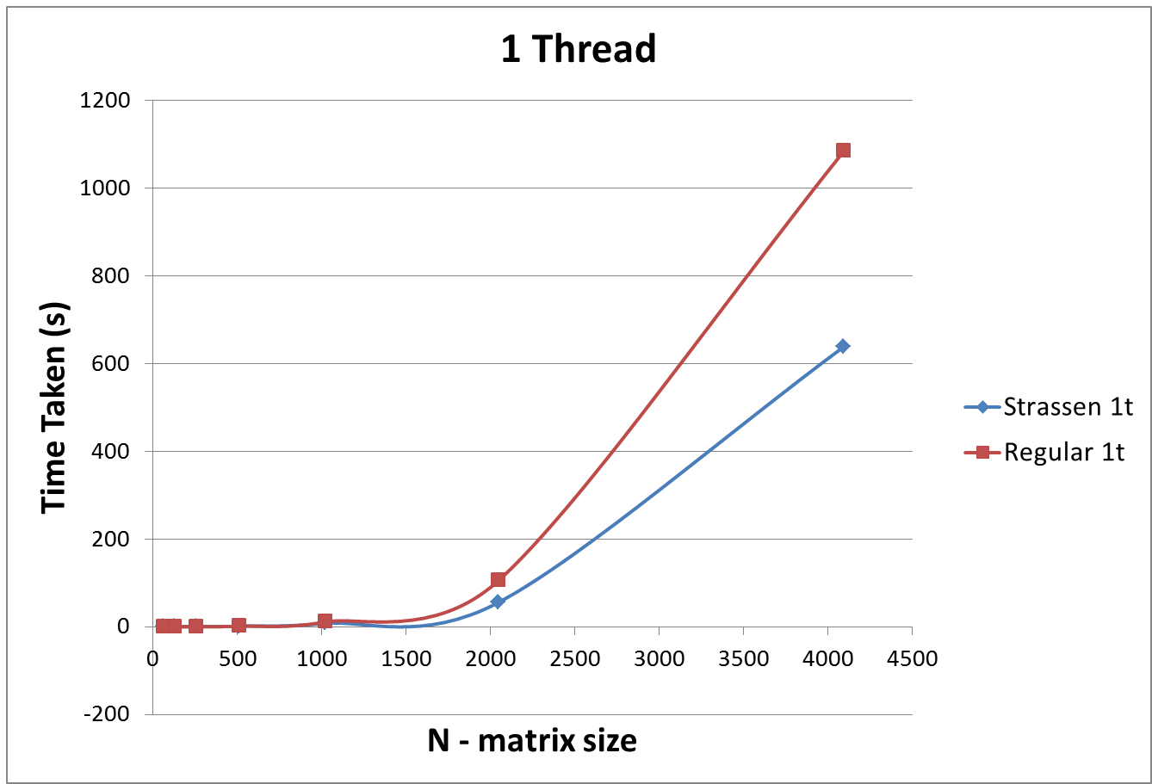
Results Single-threaded

Slide 11
Observations
Significant speedup for large matrices
Strassen algorithm slower for smaller matrices
Parallel algorithm is faster than serial one.
Granularity changes for different matrix sizes to avoid memory overflow.

